Slide 1
Datacenter and Renewable Energy
Justification report
Group 3 : Rind Alhage, Kai Zhang, Yan Chen, Icare Sakr

Slide 2
Objective of our model
Background : Web giants such as Google are increasingly looking for using renewable energy to power and cool their data centres. By producing/using renewable energy on-site, they can reduce emissions and costs compared to traditional electricity, while greening their image with customers. Solar PV and wind power are most commonly used to generate electricity. And other synergies can be created for cooling conditions, like natural ventilation (wind + fans) or hydraulic systems (water).
Objective : We propose to exploit the system engineering approach on the theme of the installation of data centres of Google in certain regions of Lebanon with high levels of insolation and wind to reduce the necessary energy consumption to supply and ventilate the data centres.
Challenge : Climate will influence electricity generation capability every day. It cannot supply the client with electricity at constant power. Meanwhile, data flow from the data center change constantly. More data flow is processed, more temperature will be generated by the data center so that more electricity consumption of cooling condition for cooling data center. But, if the cooling conditions can’t cool the data center sufficiently, it will influence the performance of data center.

Slide 3
Simplification
Data center is a very important part of Google to provide a high-quality service for users. The stable operation of the data center is crucial under changing data flows. The sufficient high-qualify electricity supply becomes a key point to drive the relative equipement.
However, Google is not professional in energy. If it wants to create a team to focus on the supply plan, it will spend a lot of time and the cost is also large. So in order to deploy efficiently the data center in Lebanon, we choose to be an external service provider for Google. It is more professional and more efficient. And we just consider that Google is a client.
Usually, there are several types of renewable energy such as, wind, hydro and PV. Using all of them at the same time to generate electricity for Google would give us too many factors to consider like electricity generation cost and price of electricity. Therefore, we dropped the idea and decided to only use one renewable energy provider
If there is some surplus electricity currently, we could store it and use it later. The storage of electricity will make our project more complicated, so we just considered the electricity converted by the renewable energy provider without storage.

Slide 4
Contents
Operational Analysis
System Analysis
Physical Architecture
Sub-systems

Slide 5
Operational Analysis (OA)
Steps for OA :
Our focus and simplification
Definition of the elements
Diagrams
Challenges

Slide 6
Operational Analysis - Our focus
Operational Analysis is the first part of this project. It only focuses on the user and stakeholder needs. In the operational analysis, we define several key stakeholders, such as Google, electricity service provider, traditional/renewable electricity provider, and key actors in stakeholders are also considered. Through establishing stakeholders’ operational activities, we know generally their interactions.
In our system, traditional/renewable electricity providers provide electricity to an energy service provider. Then the energy service provider makes a supply plan for Google. Google will adjust its strategy according to the supply plan.

Slide 7
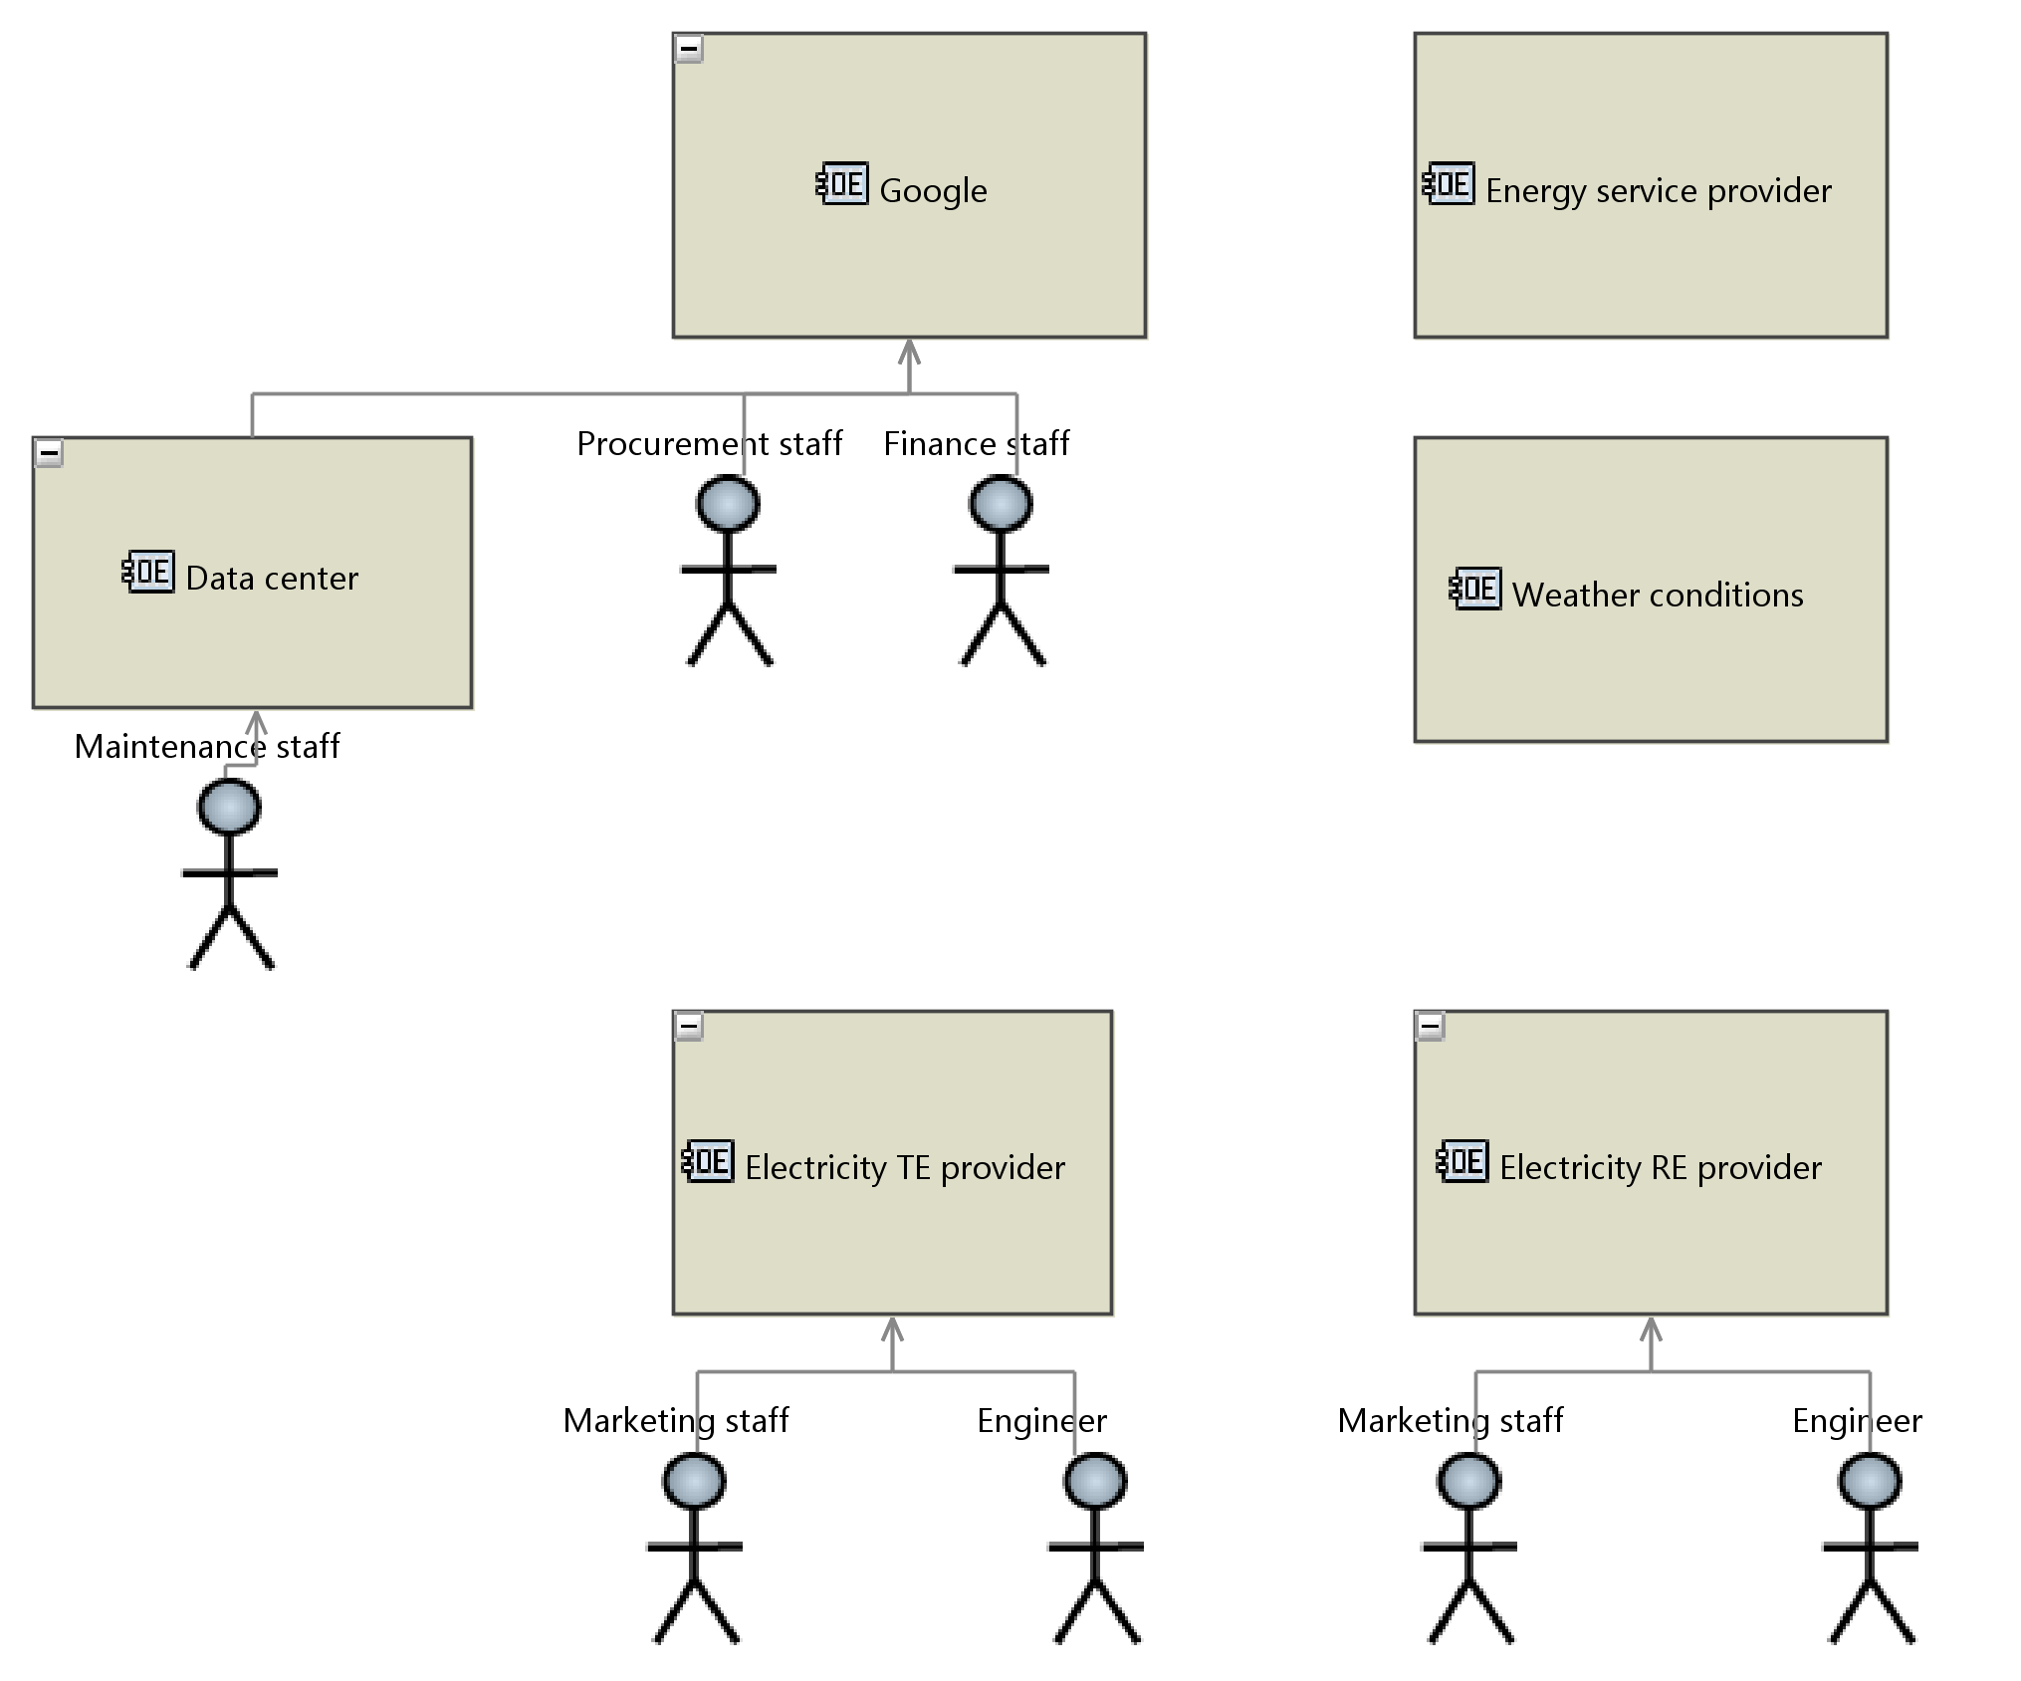
Operational Analysis - Simplification
Actually, simplicity will be necessary to reduce the complexity of our system including several entities. Each of them could be regarded as one complicated system including numerous functions, but it is not our focus. We just regard them as external entities and analyse their interactions. We don’t care about the details and just focus on the needs and feasibility of creating a system that satisfies those needs.
Google company has numerous different types of staff, they coordinate their work with each other. But in our system, we just consider procurement and finance staff. Other staff not related to our system will not be considered.
There are several methods for cooling the equipments of data center such as, putting the equipments into cold water, driving fans in data center by the natural wind and electric cooling conditions. If we consider all of them, it’s a very complicated problem. So we just think that the data center will be cooled by cooling conditions (fans) driven by electricity. The electricity is produced using renewable energy.

Slide 8
Operational Analysis - Definition of the elements
In this operational analysis, we define some diagrams including
OEBD (Operational Entity Breakdown),
OCB (Operational Capabilities Blank),
OAB (Operational Architecture Blank),
OABD (Operational Activity Breakdown),
OES (Entity Scenario).
The OEBD defines the stakeholders (entities and actors) in our system. The OABD shows the necessary operational activities. The operational capabilities and their links to the entities are defined in the diagram OCB. The diagram OAB generally shows our system’s operational process and how our system works. OES explains and details how the activities work in chronological order.
In this system, the stakeholders needs are complicated and the supply relations are not simple. Therefore, we try to define step by step the visualization of operational architecture to make the system more easily analysed and more comprehensive.

Slide 9
Operational Analysis - OEBD
First of all, we define the entities and actors in the diagram OEBD (Operational Entity Breakdown) presenting the general organism relation. We focus on 6 entities, like Google data center (client), electricity service provider...
Electricity TE[1] provider here generates electricity from traditional energy (fossil fuels), such as diesel and gas.
Electricity RE[2] provider only generates electricity from renewable energy, such as wind and solar.
The energy service provider just makes a supply plan of electricity for Google company according to information from other entities.
Usually, some staff in these entities focus on their functions in this system. For example, marketing staff is in charge of the electricity trade. Through the diagram, we can know quickly the organism structure of the system.
[1] TE : traditional energy (fossil fuels)
[2] RE : renewable energy (wind, solar)

Slide 10
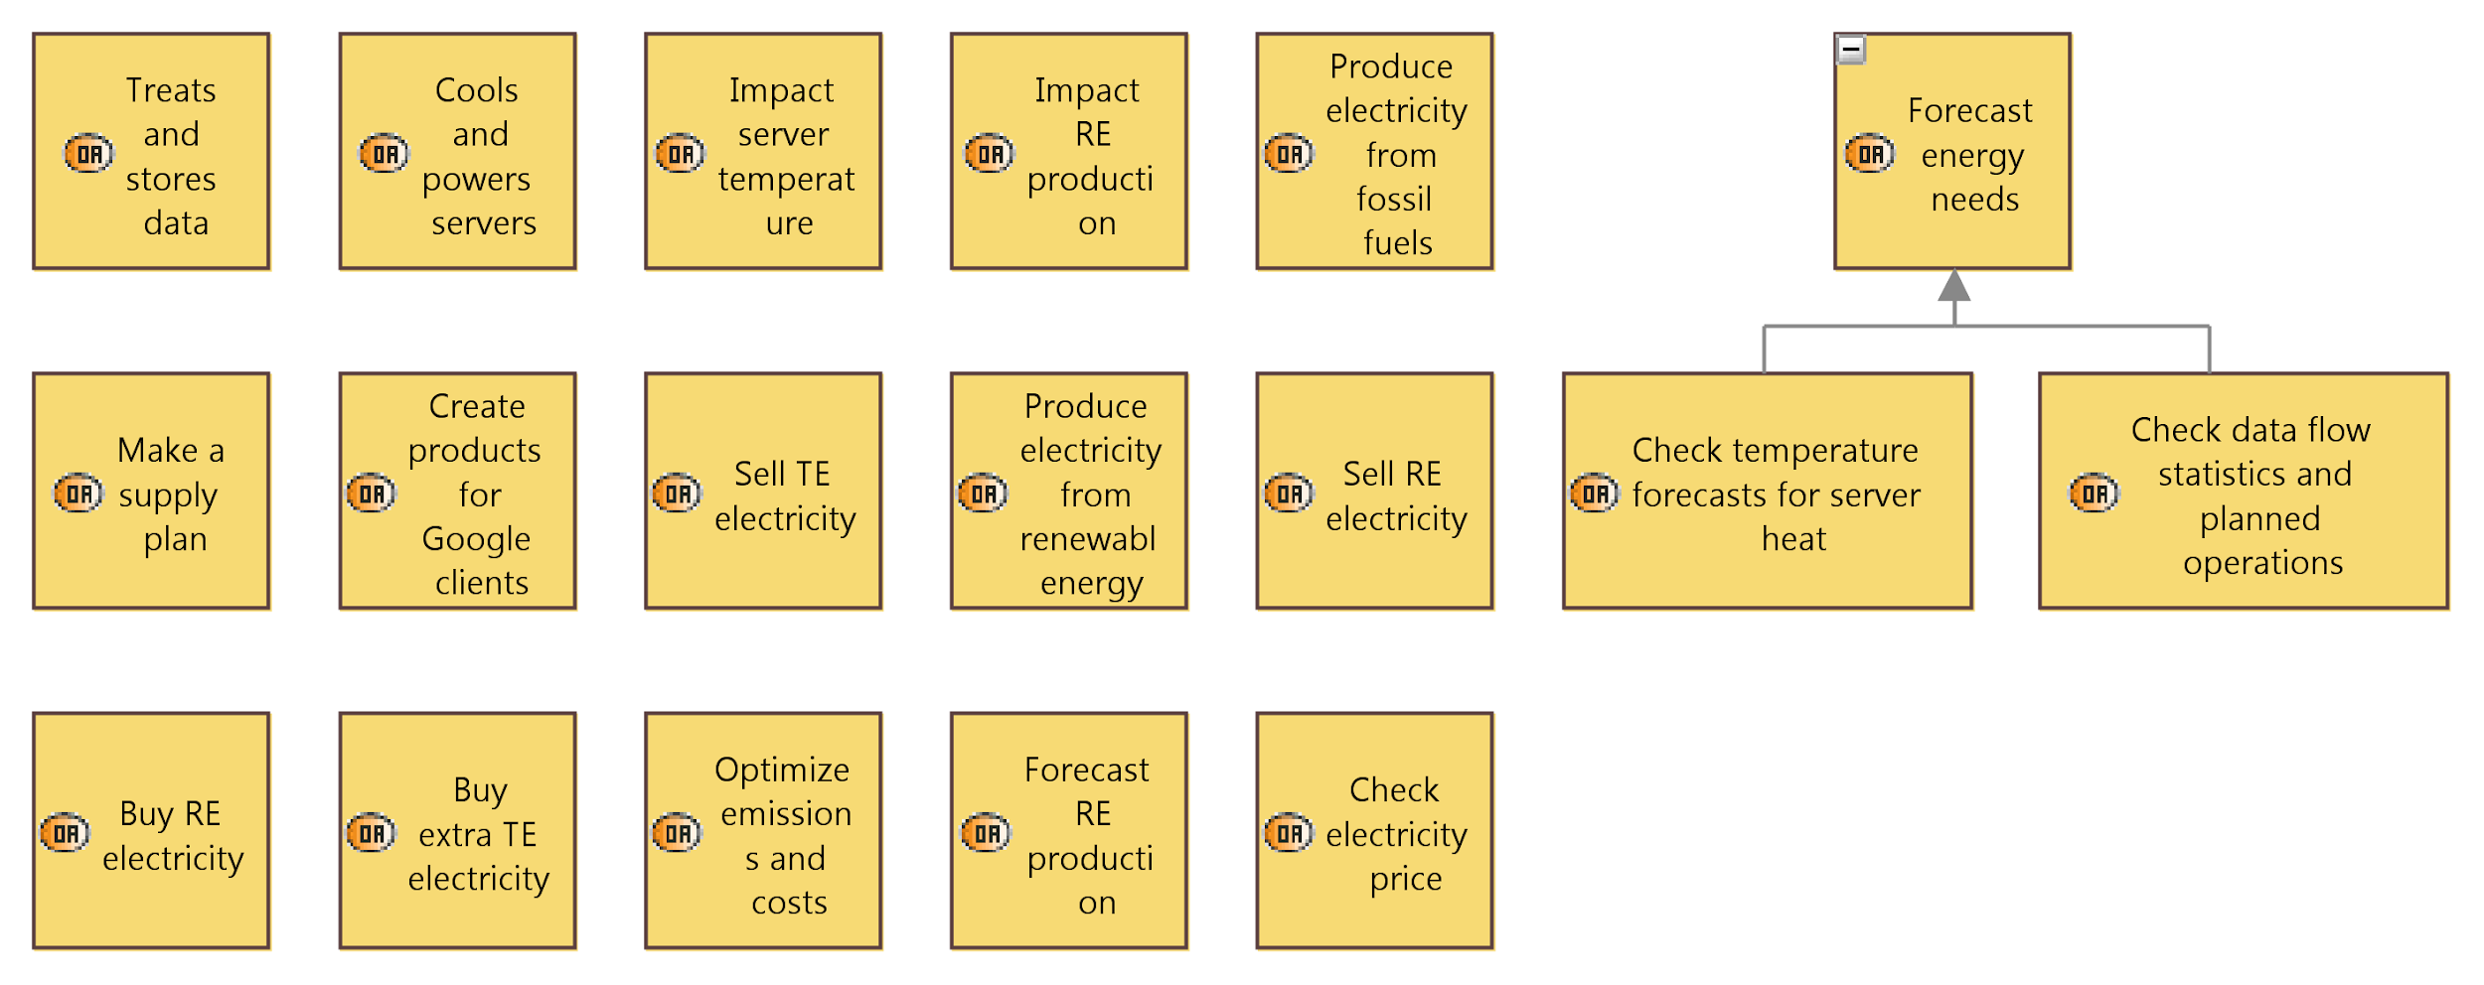
Operational Analysis - OABD
These operational activities listed here are basic elements for our system. They will be interlinked and analysed in the following diagram (operational activity breakdown).

Slide 11
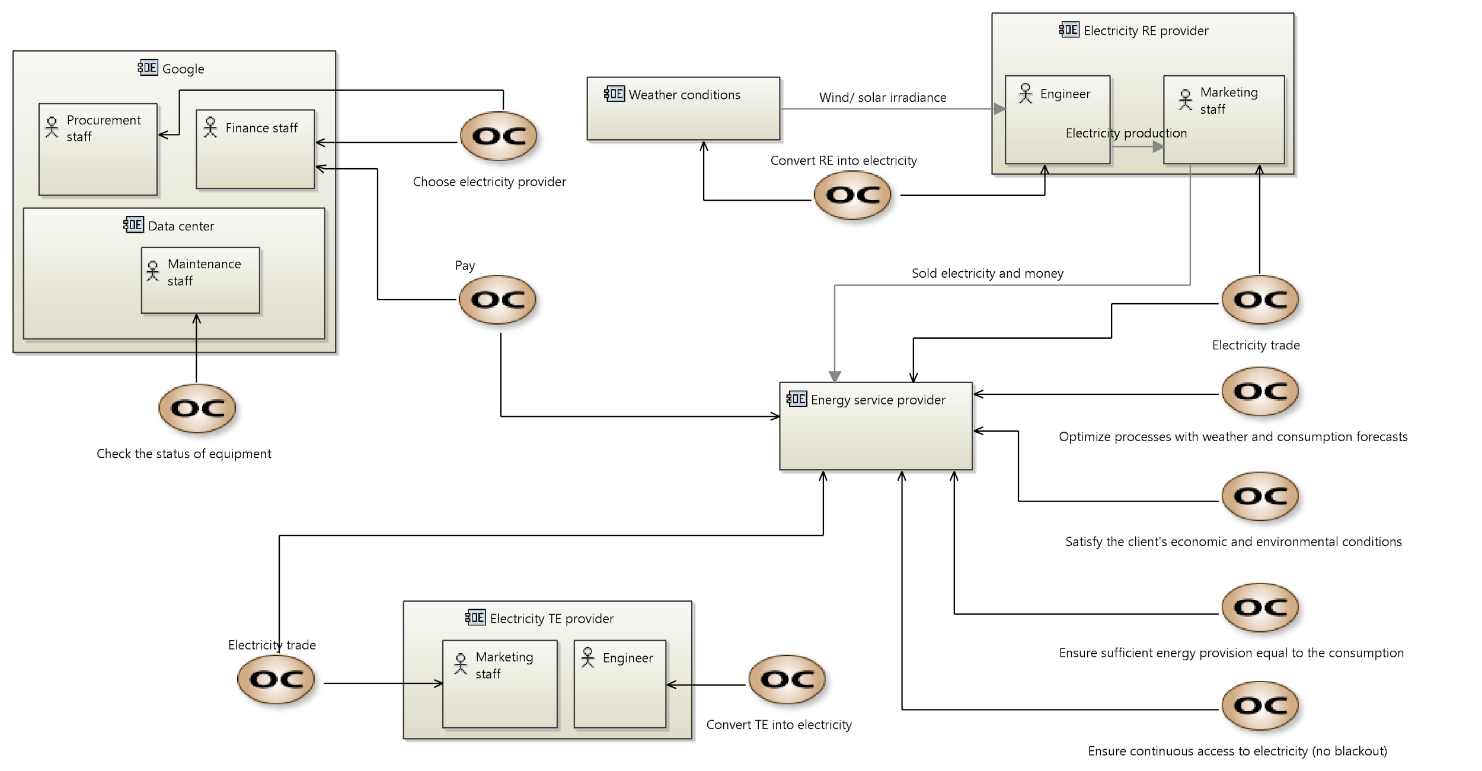
Operational Analysis - OCB
This diagram OCB (Operational Capability Blank) connects entities, actors and capabilities, and presents more interaction details. These capabilities mean that actors in entities should engage a particular function in the system. Several actors could have the same capabilities.
For example, the marketing staff of electricity RE provider sells the electricity to the energy service provider, and the energy service provider will buy it. So the electricity trade is a common capability for the two entities.

Slide 12
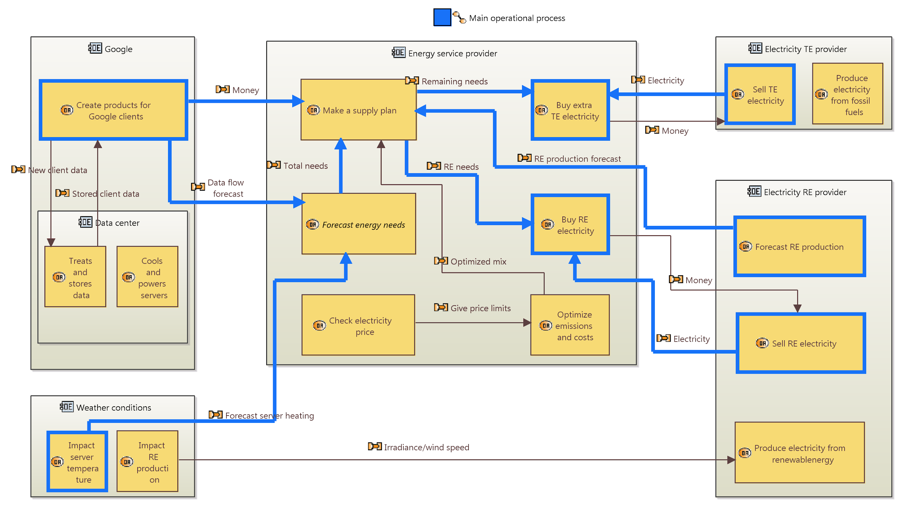
Operational Analysis - OAB
The OAB (Operational Architecture Blank) illustrates the main operational process of this system. We focus on the operational entities and operational activities.
In this system, we assume that we prioritise the use of electricity converted by renewable energy. If the electricity supply does not fit the assumed needs, we need to use the electricity converted by traditional energy to complete the needs.
The electricity RE provider forecasts renewable energy production and provides the forecast information to energy service provider. Meanwhile, it sells the electricity converted by renewable energy to the energy service provider.
The energy service provider combines the data flow forecast from google, the weather temperature around the data center and electricity production from renewable energy forecast, and makes a supply plan for google company. Google buys electricity service provided by the energy service provider according to its needs.

Slide 13
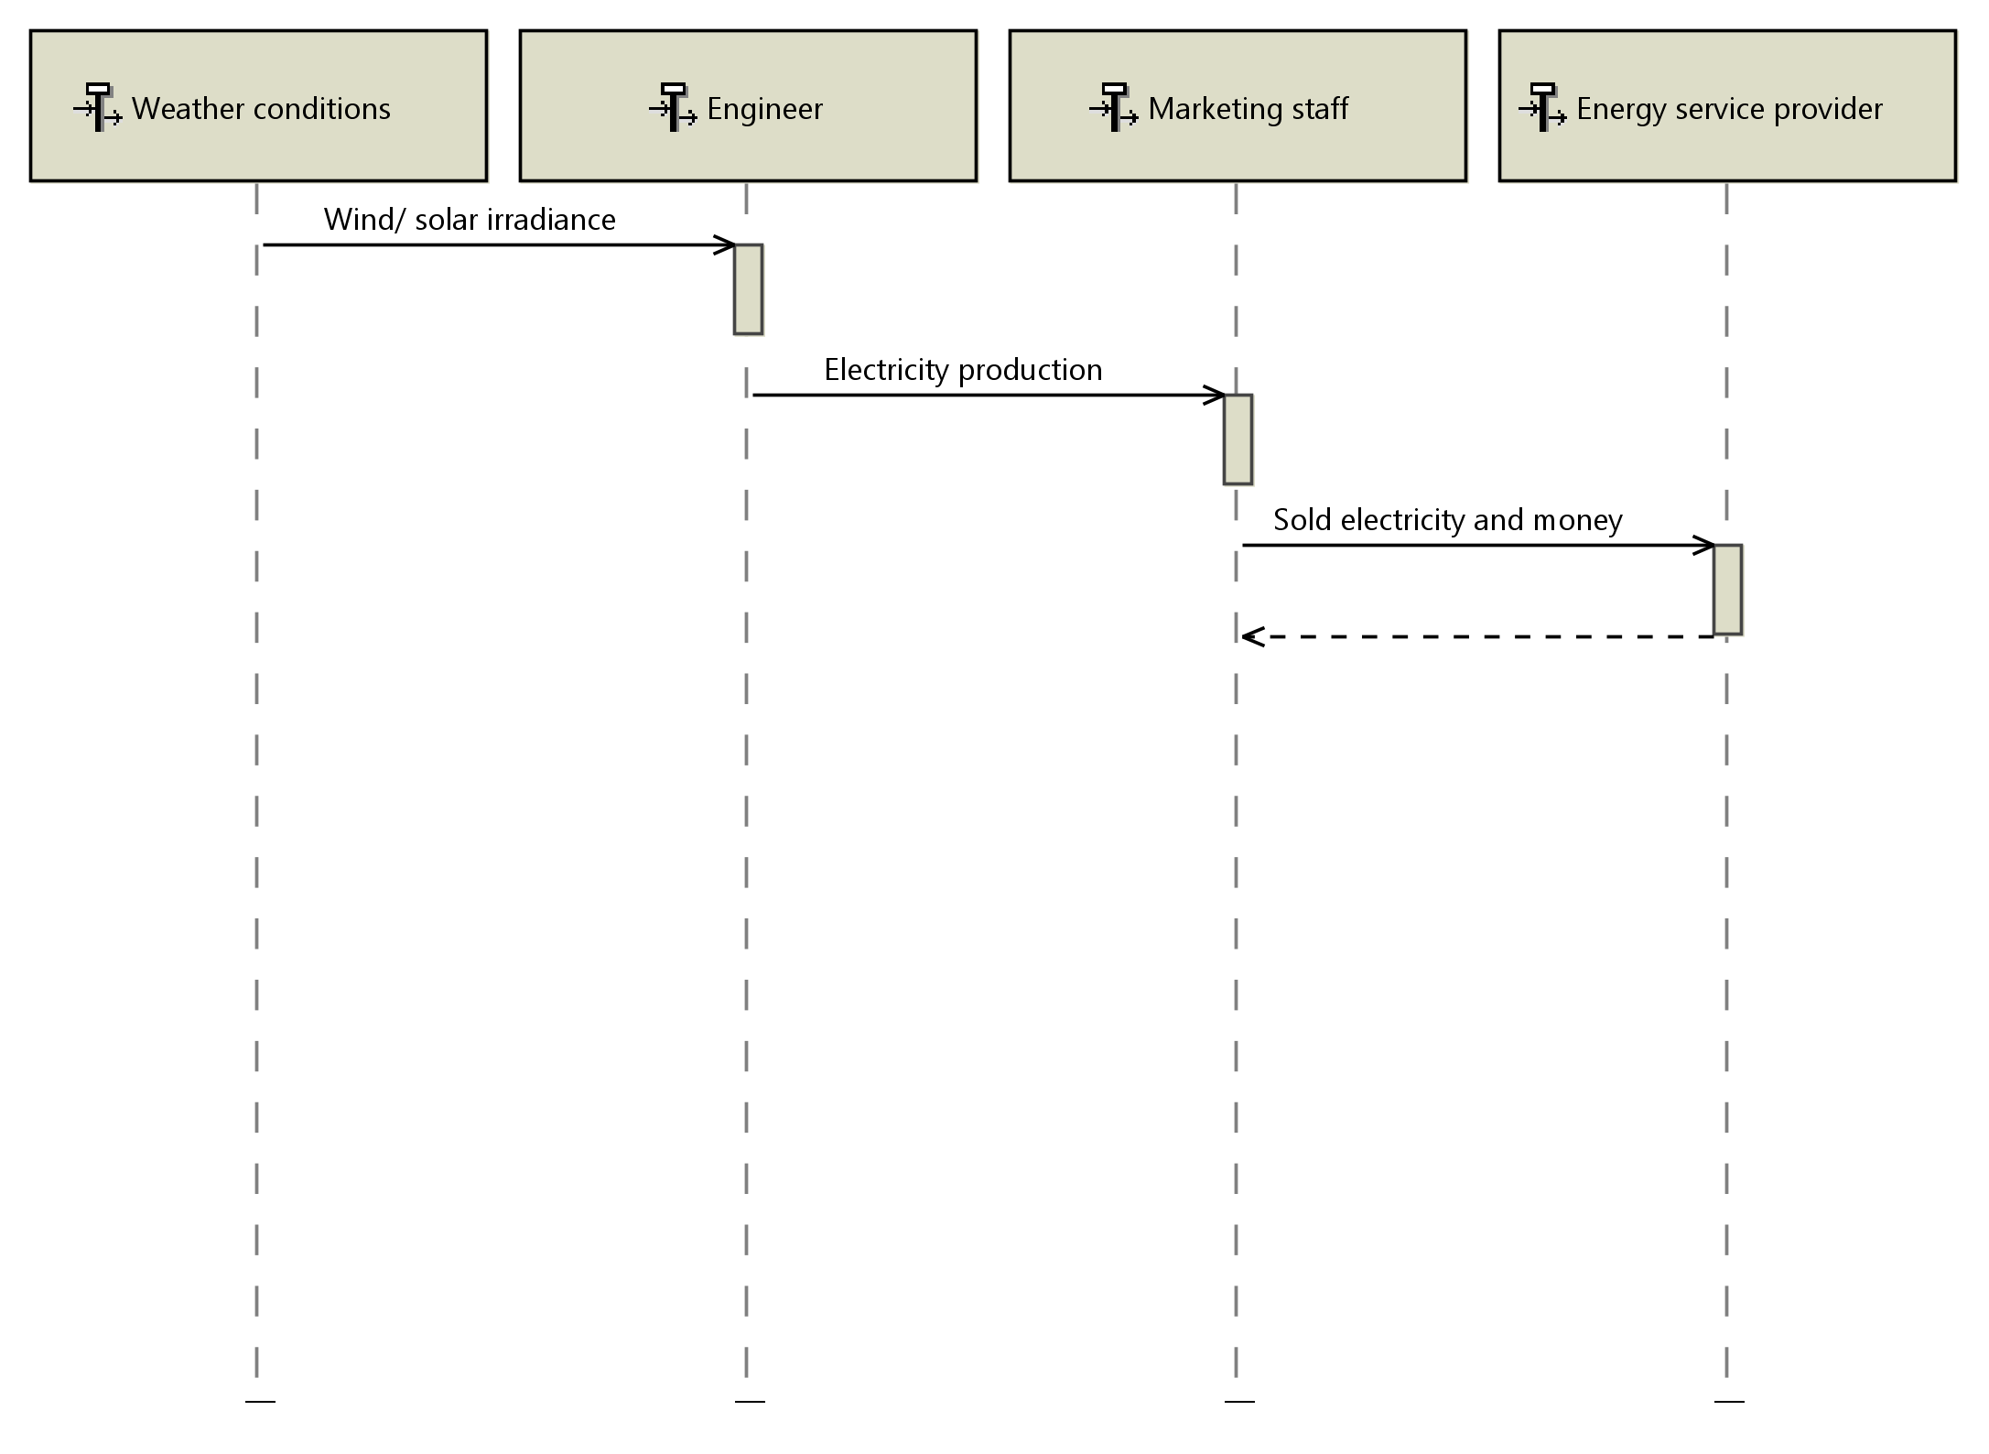
Operational analysis - OES
The entity scenario presents the process of electricity produced and electricity sold. A similar process can be found in the traditional energy production and selling. The simple presentation makes the process from renewable energy collection to selling more clear. There are also other entity scenarios, such as OES - Make supply plan and OES - cooling the Google data center.
OES - Convert RE into electricity

Slide 14
Operational analysis - Challenges
Generated electrical energy : It is hard to guarantee the stable generated electrical energy every day due to the variable climate. So in order to respond to green and environmental protection, we assume that Google prioritises the use of electricity converted by renewable energy. If it is not enough, electricity converted by traditional energy will be used. (This changes in the SA due to variabilities)
Price of electricity : The price of electricity is unknown. We can’t really know the price in our project. May be price of electricity converted by renewable energy is more expensive than the other. Google may be use electricity whose price is cheaper in consideration of lower cost. In our system, we advocate that Google doesn’t care about the price of electricity and prioritise use of electricity converted by renewable energy.

Slide 15
2. System Analysis (SA)
Steps for SA:
Our focus and simplification
Diagrams and variabilities
Challenges

Slide 16
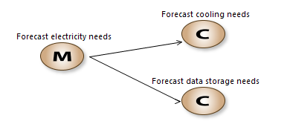
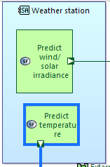
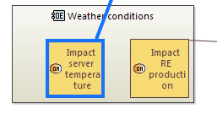
System Analysis - focus and simplification
In the SA analysis, we try to define the main objective of our system, including its missions and the corresponding capabilities to support the missions.
We find some similarities between the operational activities (in OAB) and several system functions (in SAB), which are made from different points of view, that of the system not the actors and entities. The exchange data between functions is also specified to make the system clear and logical.

Slide 17
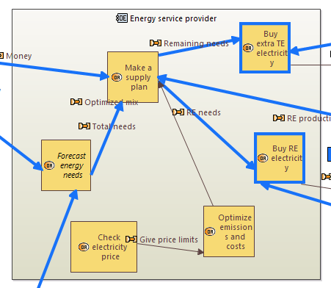
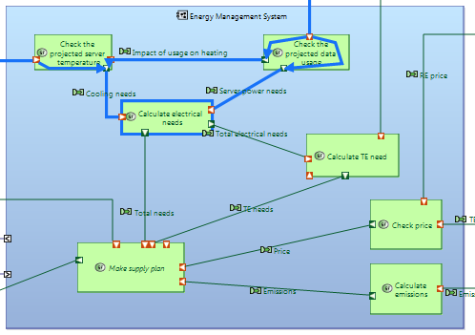
System Analysis - focus and simplification
We also make the role of each entity clear. For example, in OA, the Energy service provider works like a campanny in charges of everything, including buying electricity and developing a plan, but in SA, it is more like a software that focuses on making several propositions for future electricity usage. This is more logical and safer to have the human’s confirmation before taking actions. What’s more, after the modification, our system can run in continuous mode and work for more than one datacenter, which gives possibilities to optimize the supply plan among multiple datacenters.

Slide 18
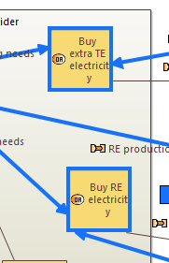
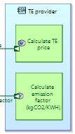
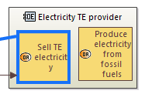

System Analysis - focus and simplification
To emphasize the role of our energy management system (EMS), we simplify those trivial activities. For example, the activity of purchasing electricity from providers is eliminated in the energy management system. We decided that the EMS will only provide the supply plan and the datacenter will purchase electricity directly. Additionally, the activity of producing electricity is removed from electricity provider since we are only interested in our system, and only show functions of external actors if they interact with our system.

Slide 19
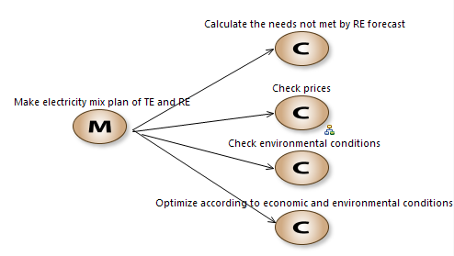
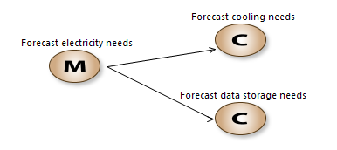
System Analysis - diagrams - [MCB] mission capabilities
We defined two missions in the system, one is to forecast the electricity needs of the datacenter, the other one is to make the supply plan. The first mission is related to the datacenter and weather station, and the other one is concerned with the weather station and electricity providers.

Slide 20
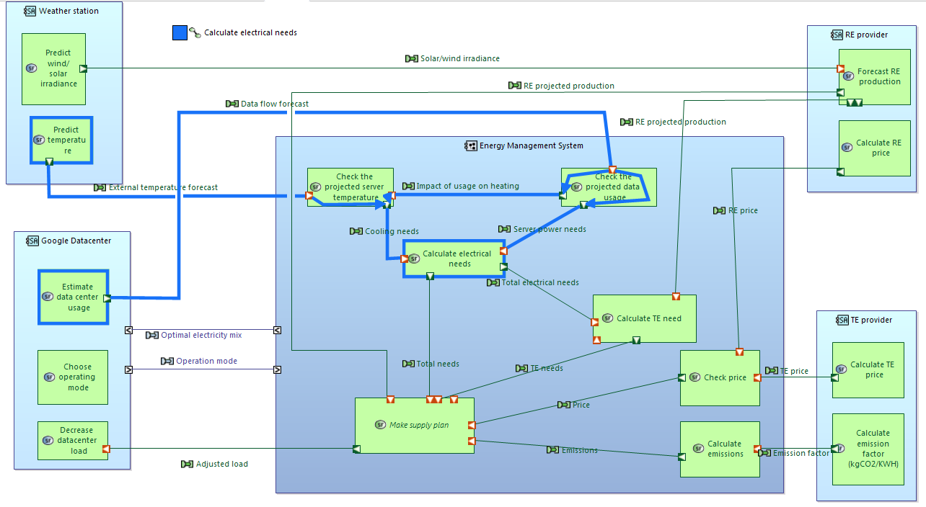
System Analysis - diagrams - [SAB] structure
In SAB diagram, we
Create the actors and allocate related system functions.
Add functional exchanges and component exchanges between different functions and components respectively.
Create the functional path for a specific feature.
Design the variabilities

Slide 21
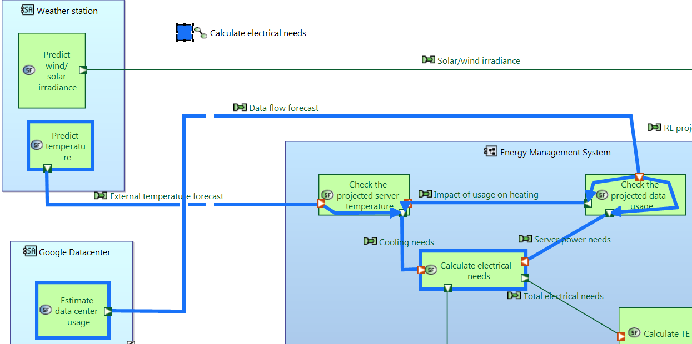
System Analysis - diagrams - [SAB] - functional path
In the functional path, we design the path to calculate electrical needs of the datacenter. It calculates the electricity needs for cooling the machines and adds them to the cost of powering the machines.
There are still other options:
Make supply plan
Calculate traditional electricity (TE) need
e.t.c

Slide 22
System Analysis - diagrams - [SAB] - variabilities
For the variabilities of our model, we considered several alternatives:
One or multiple datacenters. The system can be set to manage one or multiple datacenters. In multiple-datacenter mode, the system will develop the most appropriate supply plan for all datacenters, which might not be optimal for one datacenter.
Long-term plan or short-term plan. During making supply plan, the system can be set to make a supply plan for a long time or short time. The different modes will affect the choice of electricity providers due to the cost factor.
Renewable energy variability. This variability is related to the type of renewable energy used to produce the electricity. Several types of energy, including wind, hydropower, and sunpower, can be taken into consideration.
Operation mode variability. We can choose the different types of electricity according to our budget. For example, we can only use the electricity produced by renewable energy which is more environmentally friendly. We can also choose the mix mode, where both the RE and TE are selected.
Finally, we decide to implement the operation mode variability in our model.

Slide 23
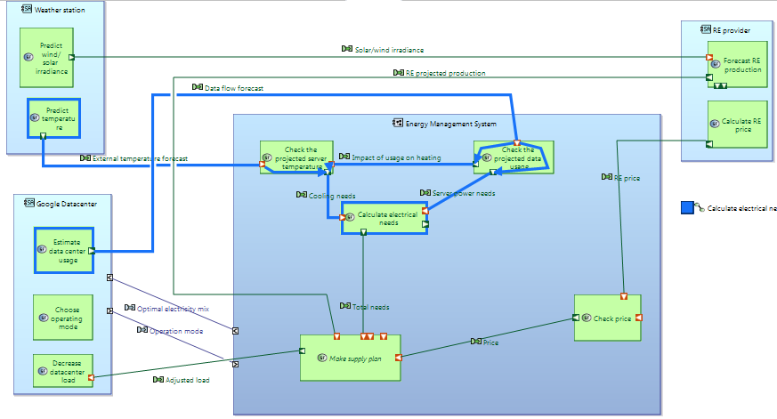
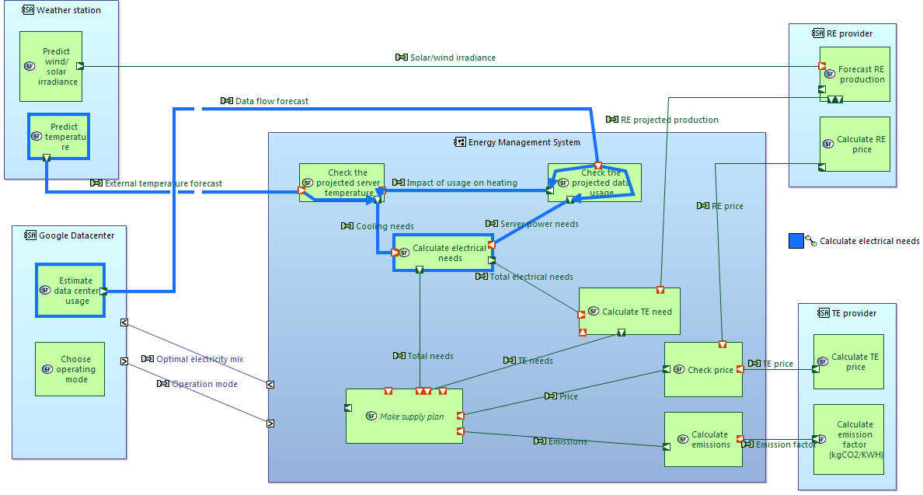
System Analysis - diagrams - [SAB] - operation mode variability
In the operation mode variability, we have the following options:
Only RE. The datacenter will use RE even when it’s not enough. In this case, it will change the data load to adapt to the amount of provided electricity.
Only TE. The datacenter can run with maximum data load because we assume the TE is unlimited and stable.
Mix RE and TE. The datacenter will use RE when provided RE is sufficient. It will also use some TE when the RE cannot meet the requirement. The percentage of TE usage can be specified to keep the datacenter running normally.
Finally, we set two modes, ECO mode(1) and MIX mode(3). The second mode is discarded because the third one is always the better choice considering the environmental factor.
ECO mode
MIX mode

Slide 24
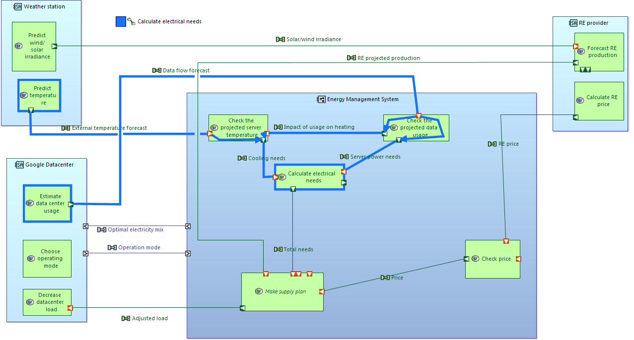
ECO mode

Slide 25
MIX mode

Slide 26
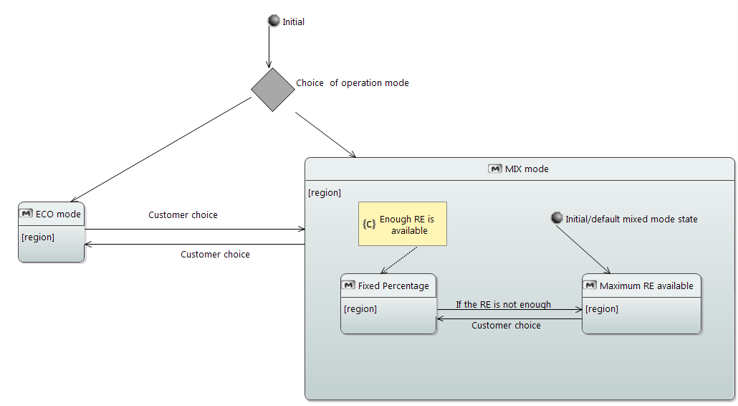
System Analysis - diagrams - [MSM] mode state machine
This diagram shows the relation between two modes and demonstrates the case when the mode will change.
For example, from the initial point, the customer can choose which mode he wants to apply. Then, the system will develop a supply plan. In MIX mode, when the RE is not enough, the system will decide to use maximum RE and some percentage of TE. The customer can also define the percentage if he wants.

Slide 27
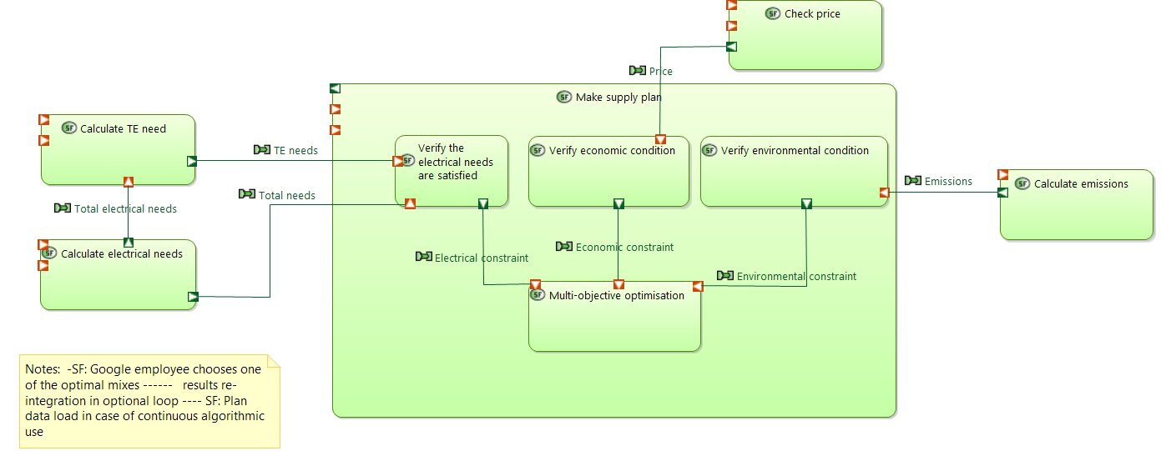
System Analysis - diagrams - [SDFB] root system function
In SDFB diagram, we put more details about the function “make supply plan”. There are other alternatives as well, like calculate electrical needs, calculate TE needs, etc. We finally choose this one because it’s the essential part in our system. This function aims to check whether all these conditions are satisfied, then make a plan for electricity supply.

Slide 28
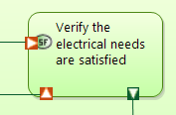

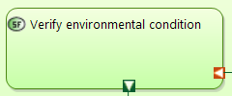
System Analysis - diagrams - [SDFB] root system function
There are three conditions when making a supply plan.
Electrical needs condition. This condition is related to the data load in the datacenter and aims to guarantee the routine work of the datacenter.
Economic condition. This condition is to verify whether this plan meets the budget of the datacenter.
Environmental condition. This condition is target to check the potential emission and pollution of the supply plan. It can be used to judge whether this datacenter is green.

Slide 29
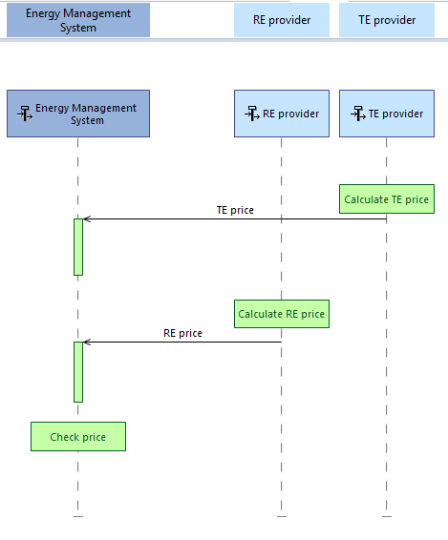
System Analysis - diagrams - [ES] check price
We design this diagram to show the function of checking price from both TE and RE electricity providers.

Slide 30
System Analysis - challenges
There are some problems we met in the system analysis. Most of them were about the balance between simplicity and variabilities. Here are some examples:
Choice of variability. Like we showed in previous slides, we proposed several variabilities, some of them are complex but useful in real applications. Due to the limited time, we have to choose a simple but important variability.
Define the boundary of each entity. It is difficult to define the role of each entity clearly. Each entity can possess a lot of functions and we need to pick the nontrivial functions.

Slide 31
3. Physical Architecture (PA)
Steps for PA:
Our focus
Definition of the elements
Diagrams and variabilities
Challenges

Slide 32
Physical Architecture - Our focus
After the first two perspectives that focused on the client and system needs, we transition towards the solution in the physical architecture. In this perspective, the focus is on defining the solution as a system with a sufficient level of detail on how it will be developed and built at both hardware and software levels. It allows to finalize the behavior and structure of the architecture including the exchanges between the components.
The complexity of our system does not stem from its number of material components as it is mostly based on software. However, we face the challenge of connecting our system with multiple existing actors and systems due to their own intricacies and complexities.

Slide 33
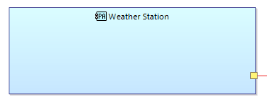

Physical Architecture - Definition of the elements
We began by trying to define the tangible structure of our physical architecture. After some initial mistakes, we understood the difference between node PCs and physical actors and were able to use them correctly. Physical actors are external systems that interact with our EMS. On the contrary, node physical components (node PCs) are tangible components that our system provides.
Therefore, we allocated physical actors to all the external systems that we don’t provide. This includes notably the cloud which we will only use (not make ourselves), as well as the actors defined in the previous perspectives (datacenter, RE and TE providers, weather station) which only interact with our main system.
A physical actor, the Weather Station and a node PC, a BUS

Slide 34
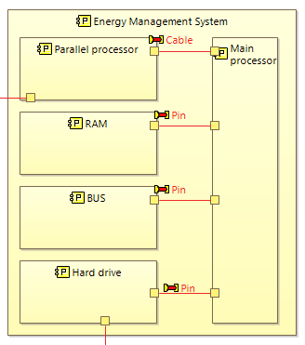

Physical Architecture - Definition of the elements
The second distinction we had to make was between node components and behavioural components. Node PCs were for tangible physical components while behaviour PCs could define an intangible behavior without material components and were more appropriate for softwares.
We had two options: either our EMS would only be software (a program installed on an existing data center computer), or it would have its own physical parts. We finally chose the second option, mainly because the system will need to treat large amounts of data, which requires significant storage and processing power perhaps not available in a classic computer. Thus, we chose to supply our own box set with dedicated processors and storage to ensure proper functioning. It will exchange with the other actors mostly over internet-based links.
However, for the subsystems that we will detail later, we decided that they would only be programs (software) installed on the existing devices of the users, so those were modeled as behavior PCs not nodes. For example, the user interface would be a software that could be installed on several devices of the data center operator without having any physical parts.
Node PC for the tangible EMS and behaviour PC for the user interface subsystem (control data and energy plans)

Slide 35
Physical Architecture - Diagrams
PAB tangible structure
This diagram presents the interacting physical actors and the node/behavior PCs representing our system with the physical links between them. The energy providers are linked to the datacenter by electrical cables. The rest of the links between actors are internet-based (wifi, fiber optics…). As for our main system, the EMS, the box set englobes:
Two processors: one for the main EMS software and another solely for communications with the subsystem softwares (linked by cable).
A hard drive to store the data on energy and usage which is downloaded from the cloud.
RAM, BUS… and other electronic components (linked by pins).

Slide 36
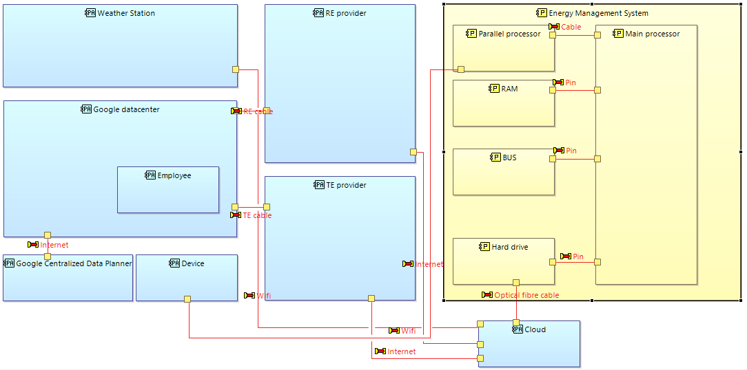
PAB: tangible structure

Slide 37
Physical Architecture - Diagrams
PAB behavioral and tangible structure
This is our main diagram for the physical structure. The components related to the subsystems will be detailed in a dedicated section. We defined some behavioral and functional components in the external actors which are needed for the interactions with the EMS. For example, the weather station uses live and stored temperature data to perform the predictions. The RE provider is responsible for giving predictions on its production and checking the market price (or providing the fixed contract price). The TE provider needs to provide its tariffs as well as an emission factor (kgCO2/kWh). The datacenter is responsible for providing the data load schedule. These missions were assumed proper to the actors since they would need the information (on prices, emissions, forecast…) anyway for their internal functioning.

Slide 38
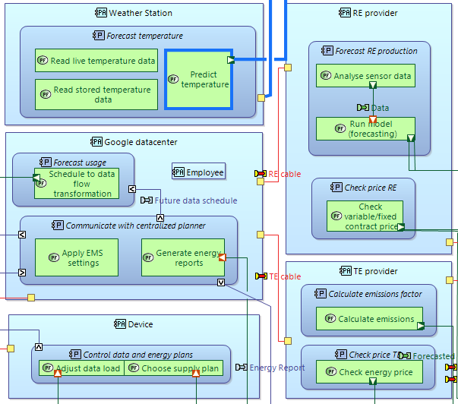
PAB behavioral and tangible structure - portion on external physical actors

Slide 39
Physical Architecture - Diagrams
PAB behavioral and tangible structure
As a software, the functions of our system are centralized in the main processor. The first three behavioral components are common and serve to gradually calculate the total energy needs:
Forecast data usage needs: the module receives a file from the datacenter with the load scheduled to flow through the server and the information is translated into energy needs to power the machines that store and treat the data. .
Forecast cooling needs: the module receives the temperature forecast file from the weather station and transforms the temperature information into data on energy use needed to cool down the servers at such temperatures. The increased use of the servers will cause additional warming which was translated into additional cooling needs.
Total energy needs calculator: the module takes the output files of the two previous functions and calculates the sum as a schedule of total energy needs for both cooling and power.
The functional and behavioral exchanges are data files containing temperature predictions and energy needs (a schedule of energy needed per time slot).

Slide 40
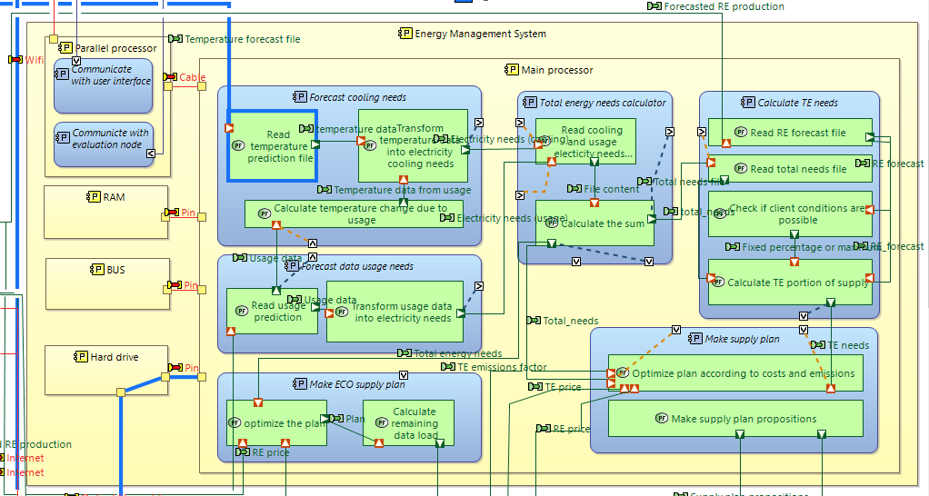
PAB behavioral and tangible structure - portion on EMS

Slide 41
Physical Architecture - Diagrams - Variabilities
PAB behavioral and tangible structure
The three remaining behavioral components are specific to the two variabilities implemented:
ECO mode: the component takes the forecasted RE production and compares it to the total energy needs to deduce any data load that needs to be reduced or sent away to another datacenter (information on remaining load sent back to the datacenter via the user interface). The optimization process is along the RE price and for example, the EMS could propose slight variations or switching to MIX mode if the price is too high.
MIX mode: To combine RE and TE, the EMS first needs to compare the RE forecast to the total needs. Then it checks if the client conditions are possible, for example if the client has a goal of 30% energy needs to be met by RE the EMS checks if that is possible given the forecast. In case the percentage cannot be met, the default option is to use all the amount of RE available and to complete the rest of the needs with TE. In a second behavioral component, the system takes the total needs and calculated TE portion, along with the energy prices and the emission factor to optimize according to economic and environmental conditions. The system will propose a set of supply plan propositions within a margin of the initial solution in order to optimize these conditions (ex. A plan with only 25% RE but much cheaper than the 30% condition).

Slide 42
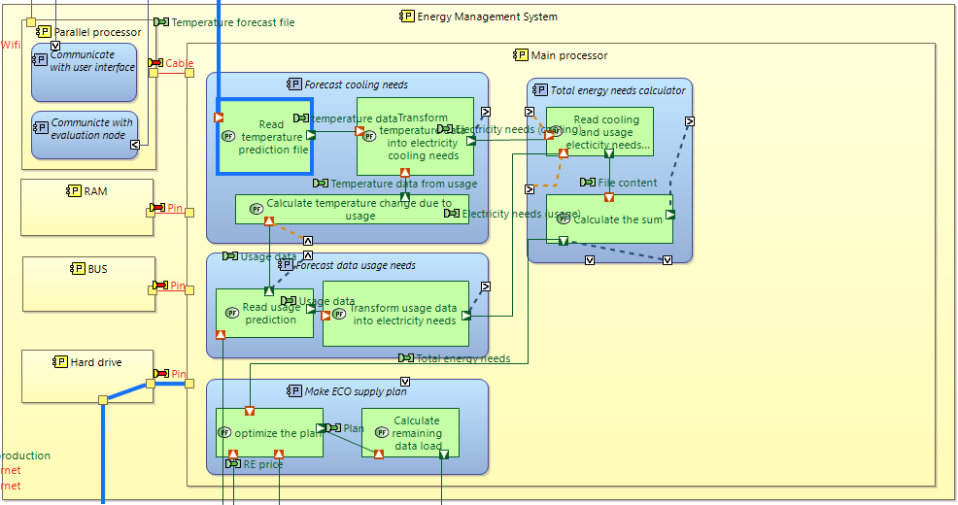
PAB behavioral and tangible structure - ECO mode

Slide 43
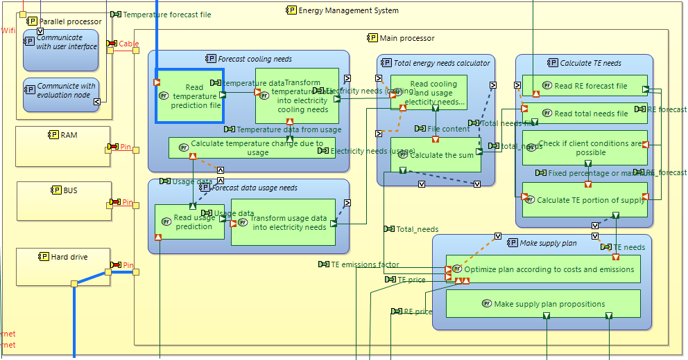
PAB behavioral and tangible structure - MIX mode

Slide 44
Physical Architecture - Diagrams
PAB behavioral and tangible structure - Functional chain / physical path
We also did a parallel between a functional chain and physical path on how to get the temperature from the weather station. It’s a direct functional exchange between “predict temperature” and “read temperature prediction file” in terms of functional chain. However, the physical path is more complex because it needs to transit through the cloud and hard drive in order to transfer and download the data to be treated.
Other options for functional chains include getting the RE or usage forecasts. In both cases, the physical path would also transit through the cloud and hard drive to the main processor, while the functional exchanges are directly between the actors’ functions and the internal functions of the EMS main processor.

Slide 45
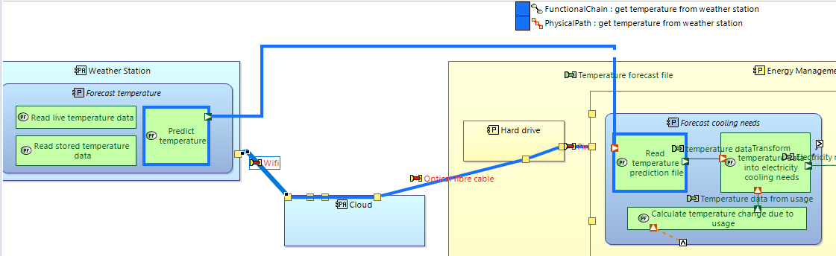
PAB behavioral and tangible structure - Functional chain / physical path

Slide 46
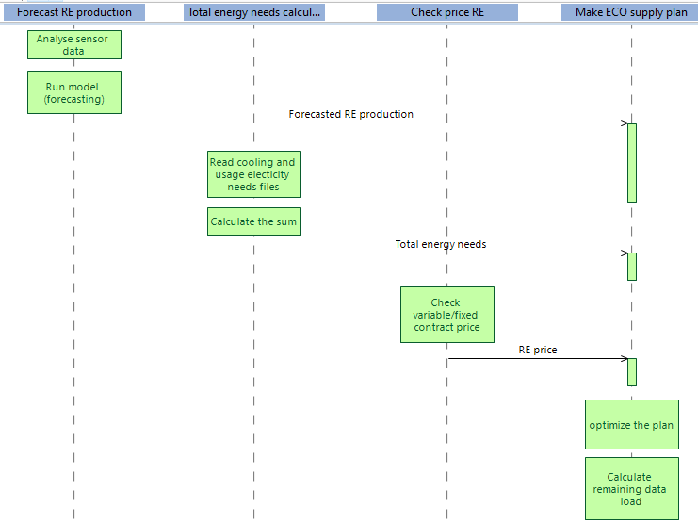
Physical Architecture - Diagrams
ES - Make ECO supply plan
This diagram retraces the explanation of ECO mode in chronological order: reading the RE forecast, comparing it to the needs, checking the price conditions before giving the final result of the remaining data load if applicable.

Slide 47
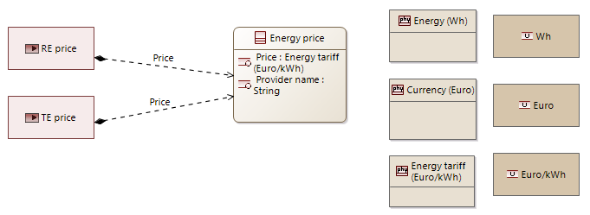
Physical Architecture - Diagrams
CDB - Energy price class
This diagram defines the exchange item on energy price which includes the name of the provider and the price in euros/kWh. This exchange item is used as a reference for all energy-related price exchanges, either RE or TE.

Slide 48
Physical Architecture - Challenges
The challenges we faced include:
Having few tangible components with a focus on software
Reliance of our EMS on multiple existing external systems
Distinguishing between actors/node PCs/behavior PCs
Clearly defining the operation modes in order to design the appropriate functions (for example introducing a function to check if the client conditions are possible in mix mode and creating a default option if they are not).
Conceiving the form of final output after the optimization process (one or multiple options)

Slide 49
4. Sub-systems
Then we define and initialize a subsystem model based on a model defined in the main system. If we define the user interface, for example as a software inside a physical node. It will mean therefore that it is in the scope of our supply and we as system integrators are responsible for its supply. However, a user interface, if we will design it by ourselves, is already a fairly complex system, so in reality, we will not do complex sub-elements of the system by ourselves, but we will decide to externalize it to another system engineering team that will take charge of developing it for us. This means that we are defining levels of engineering that are integrated in our systems, and we have an external architect at the level of the user interface that decides the choices of implementation.
In capella, there’s a function that will accelerate the workflow we described, which is the system to subsystem transition. In this transition, we initialize a capella model centralized in the user interface which will be the new system of interest and will be in interaction with elements of the main system considered as actors. Furthermore, the functions and components for the user interface in the PAB of the main system, will be considered as the specifications for the sub-system architect.

Slide 50
Subsystems
We performed a vertical SA transition for two subsystems explained in details in the slides ahead.
The user interface: linked to a single datacenter to communicate with the EMS.
The centralized multi-objective data planner software: linked to a centralized planner by the client that communicates with several datacenters.

Slide 51
Subsystem - User Interface
The user interface is a program that can be installed on several devices and operated remotely from the datacenter.
Problems faced and solved
The first problem we faced is about the physical implementation at the main system level, concerning how to send commands and data from the user interface to our energy management system, without interfering with the energy management system execution. To solve that, we decided to make a parallel processor in our EMS, that will take care of the communications and avoid overloading the main processor. We did the same thing with the communication with the centralized multi-objective data planner.
Then, we were confused about what nodes to use for the user interface and we thought first of implementing a physical component concerning the technology where the user interface will be executed (Tablet, … ), but then we decided not to put it as it would be our responsibility to provide it and we should not be limited by one possible technology (It can be installed on several devices remotely (phone or computer)).

Slide 52
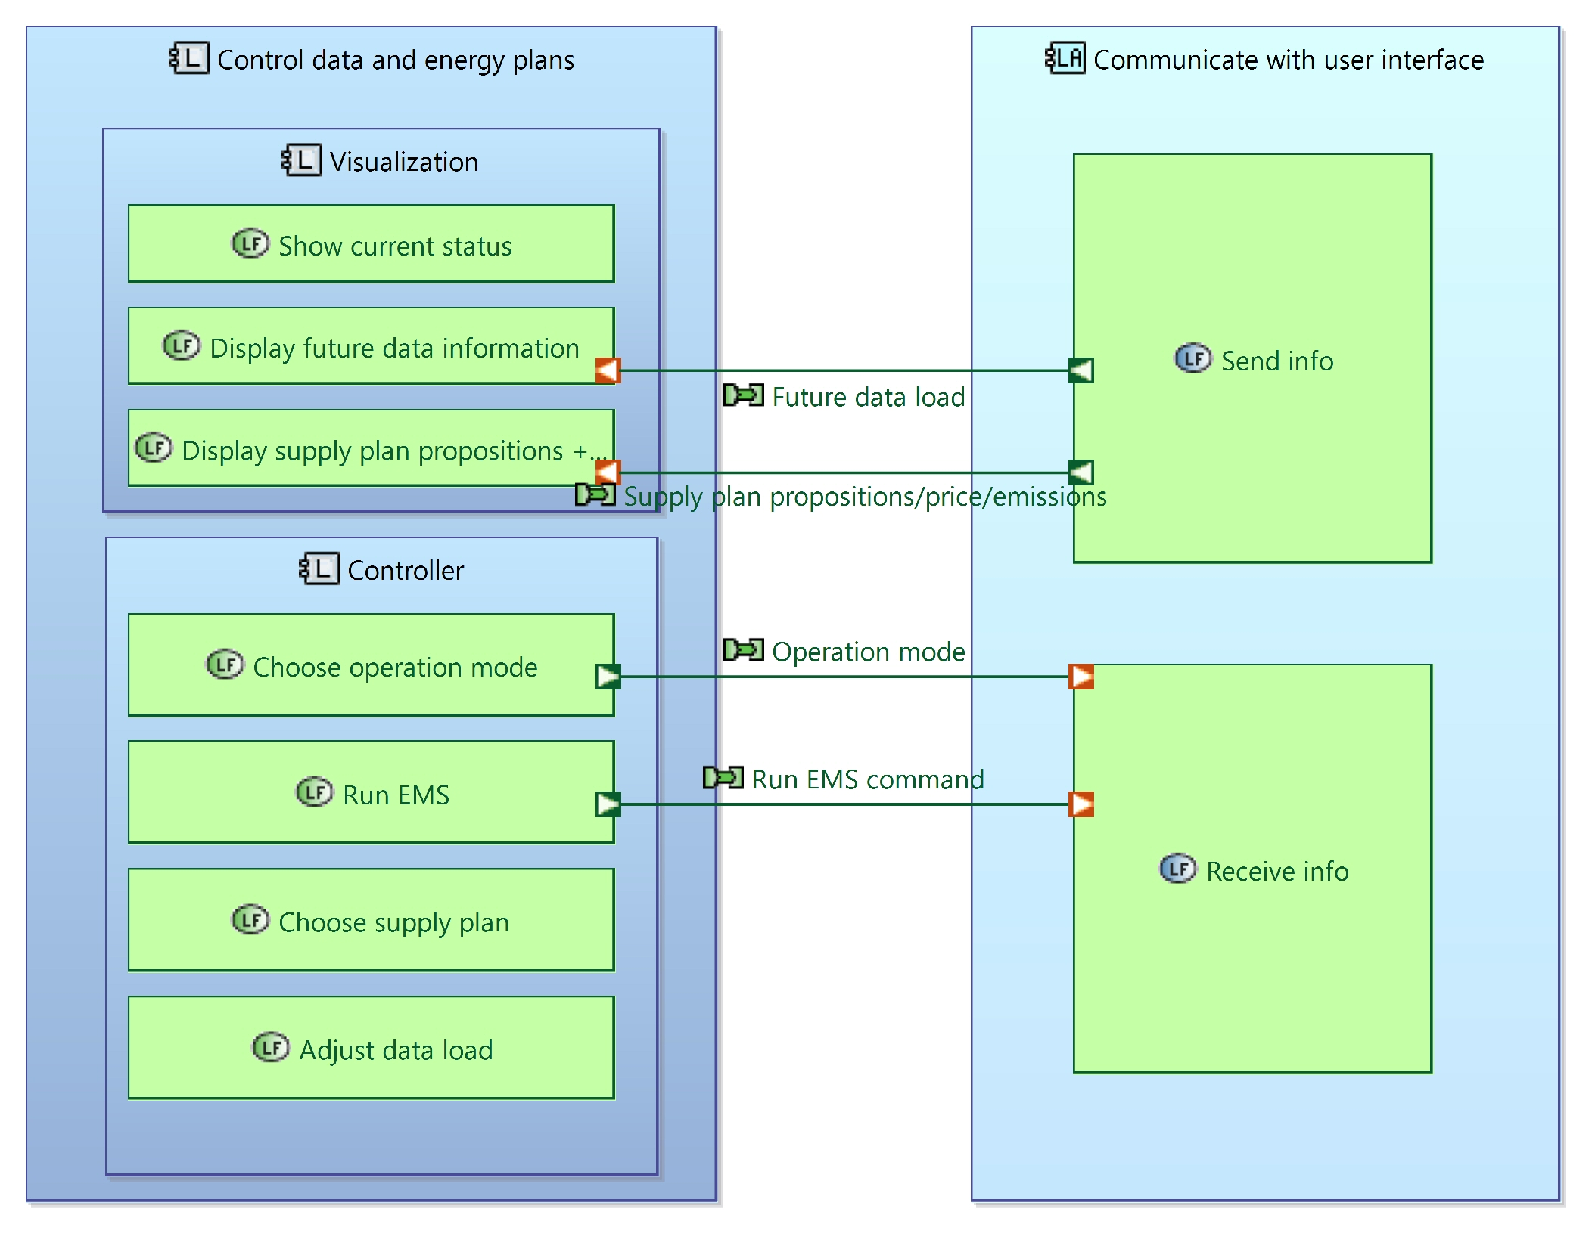
Subsystem - User Interface
LAB diagram
At the logical architecture level, the user, when operating the EMS, should be able to visualize the information about the current status of the supply plan used in a datacenter as well as the future data projected as given by the centralized planner, and the supply plan proposition given in the output of our EMS.
In the controller logical component, the user can choose the operation mode of the EMS (ECO, MIX) as well as the corresponding settings, run the EMS, choose the supply plan to adopt from the proposed ones, and adjust the dataload of the datacenter if necessary.

Slide 53
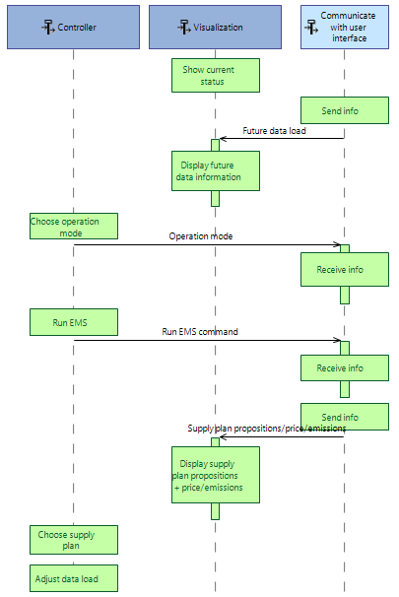
Subsystem - User Interface
ES diagram

Slide 54
Subsystem - Centralized multi-objective data planner
Principle
When designing our Energy Management System (EMS), we noted that in reality all the data centers are correlated, and the decisions (of energy management, computing speed…) made at a certain datacenter could affect the decisions made at another datacenter. For example, when setting an ECO mode for a datacenter, and in the case where the amount of renewable energy is not enough to process all the scheduled data load, the remaining load will be sent back to the centralized planner, to distribute it on other data centers which will affect their performances. Therefore, we thought that we needed a centralized planning algorithm that takes into consideration all the energy and computing decisions made locally, to generate optimal data distributions that consist of a pareto front of non dominated solutions. This makes sense when we are planning for data centers that are using our EMS.
The idea behind the multi-objective data planner is to generate optimal distributions of data (at multiple data centers that use our EMS) taking into consideration the load balancing reports (response time, overloading) (giving a metric about the overall processing efficiency) and the energy reports generated by our EMS (giving a metric of power efficiency) at each data center.

Slide 55
Subsystem - Centralized multi-objective data planner
Genetic algorithms NSGA-II and LAB diagram
The NSGA-II is a robust stochastic multi-objective optimization algorithm that has demonstrated its ability to handle very complex problems in a fully automated manner.
The initialization parameters of the algorithm (stopping condition, mutation rate, population size, ...) are not quantifiable and strongly depend on the objective functions, constraints. They can be the result of trial and error, or machine learning approaches.Therefore, we created a separate logical component for initialization in the LAB diagram. The algorithm node logical component will run the NSGA-II core and read reports of the objective functions as well as show the optimal pareto front. The Run NSGA-II core function is the main core of the algorithm, that will generate an initial population (set of individuals where each individual is a chromosome encoding a possible setting of data distribution and the EMS mode setting at each datacenter), send the population for evaluation (energy reports and load balancing reports) then perform the 3 operations of the genetic algorithm (selection, mutation and crossover) between individuals (in a loop until a number of iterations).
Finally, the physical component of communication with data centers will evaluate the objective functions of each individual (data & energy planning possibility).

Slide 56
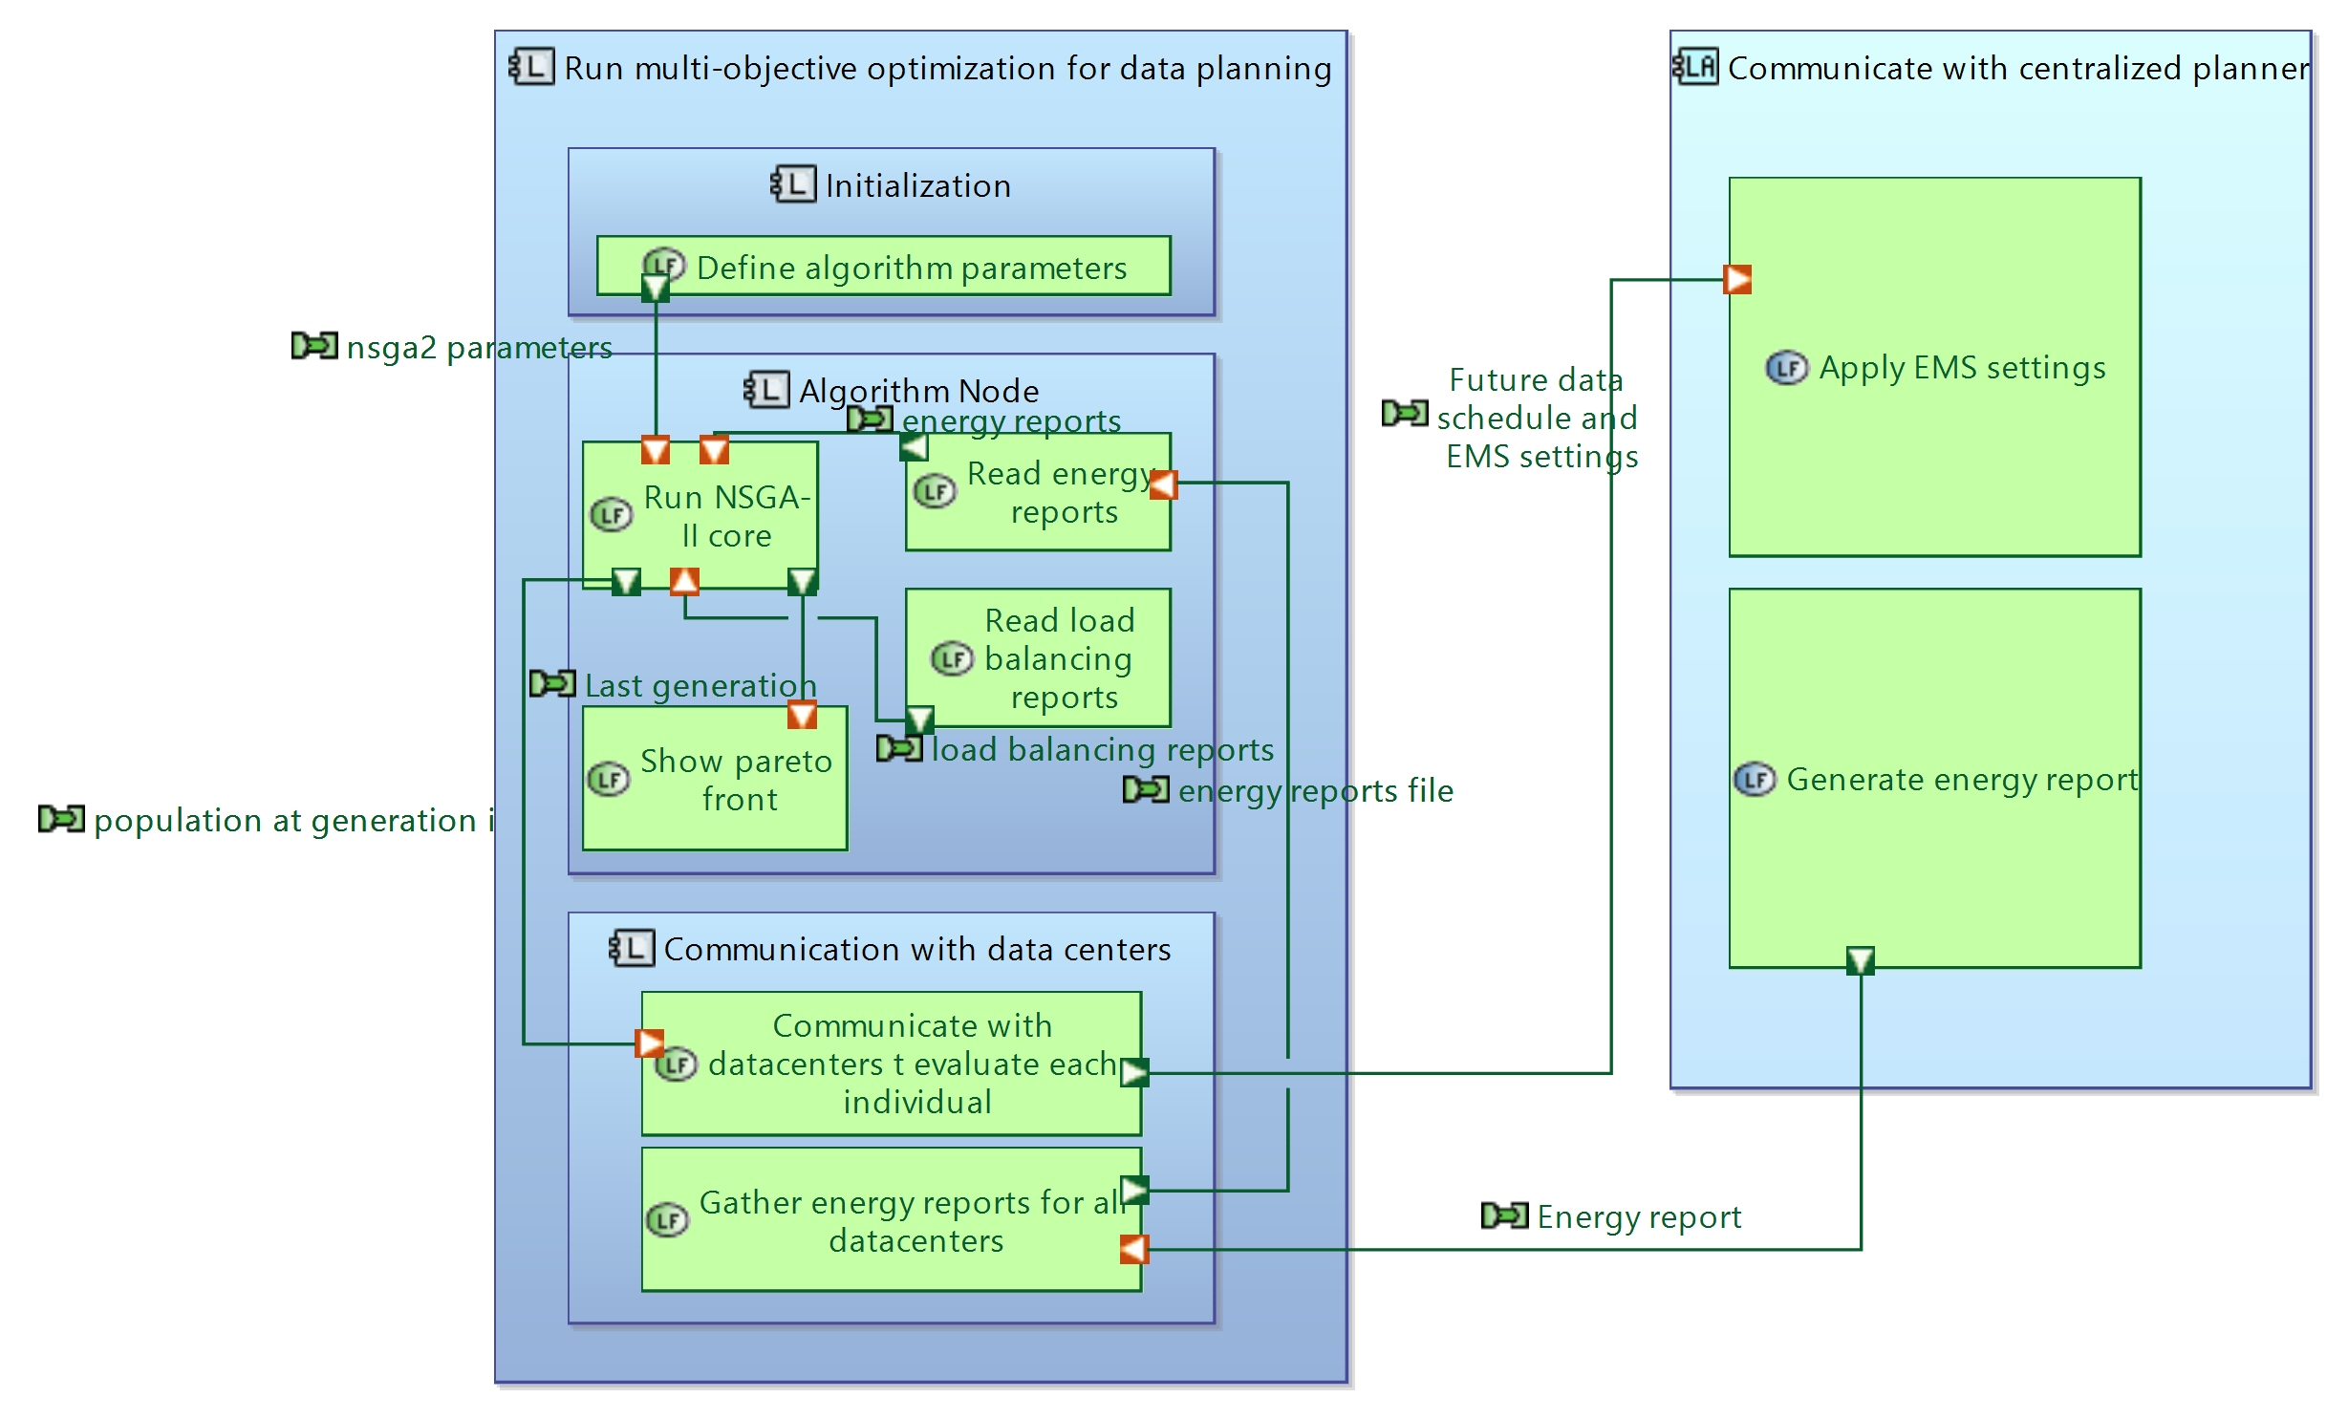
Subsystem - Centralized multi-objective data planner
LAB diagram

Slide 57
Subsystem - Centralized multi-objective data planner
Example with 2 data centers and ES diagram
For example, if we have two datacenters using our EMS, the centralized data planner will run the NSGA-II core, and generate a population of n individuals. Each individual is a possibility of how the data is distributed among those 2 datacenters, and the EMS mode settings at each data center. Each individual will be evaluated. For an evaluation of a certain individual, the centralized multi-objective data planner will communicate with the 2 datacenters and send them the future data schedule and mode settings as coded by that individual. Then, the 2 datacenters will send back feedbacks (reports) about the “fitness” of that individual in terms of energy efficiency (CO2 emissions, Price…) and load balancing efficiency (response time, computing overload). After evaluation of all the individuals, the NSGA-II will read the reports and select the K best (non-dominated individuals) and perform the 3 genetic algorithm operations defined previously, the process is then repeated to do a stochastic research in the space of possible data distributions and EMS mode settings.

Slide 58
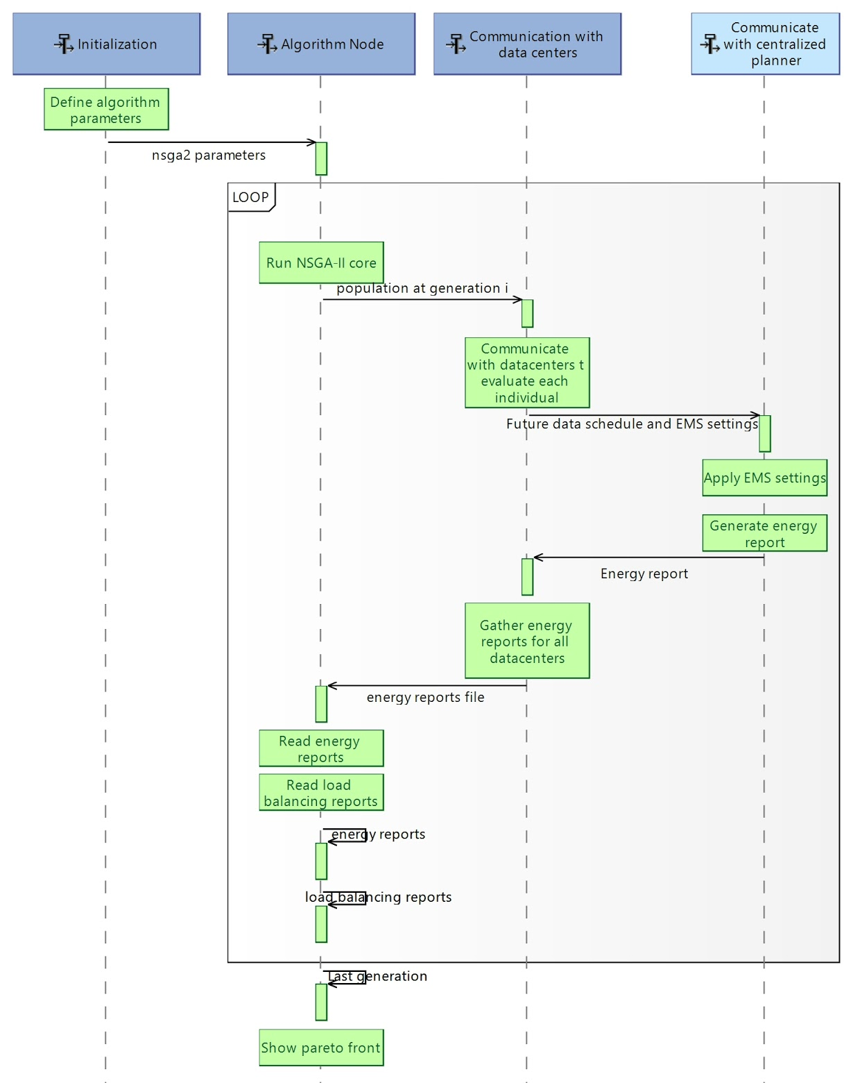
Subsystem - Centralized multi-objective data planner
Exchange scenario diagram (ES)

Slide 59
Problems encountered
In terms of representation, we encountered the problem that we couldn’t find a way to represent in the exchange scenario and in the logical architecture, the fact that we are communicating with n data centers and not with only one.

Slide 60
Conclusion
In terms of conclusion, we created the EMS solution, that covers as much as we could, in the constraints of the project, the needs of the datacenter client in terms of optimizing its energy supply plan. However, our EMS is not limited to datacenters, we can imagine it being used for any factory or even for homes, to help the planet we live in become a better place, and, following Bill Gates’ vision [1], help avoid a future climate disaster while still running our innovative activities optimally.
Furthermore, we can think of improving our EMS model by adding more variabilities, such as considering natural ventilation as an optimization parameter as well as geolocalization, extending the model to explore countries with favorable climates.
[1] Bill Gates, How to avoid a climate disaster: The Solutions We Have and the Breakthroughs We Need

